Slide 1

Universidad de las Fuerzas Armadas ESPE
Object oriented programming
Name of group: Encapsulated Knowledge
Members:
Gudiño Bryan
Loza Steven
Hidalgo Mikael
NRC: 28834
OOP_KNOWLEDGE_ENCAPSULATED

Slide 2

Transform Your Tire Business
An inventory control solution for tire shops in southern Quito

Slide 3

The Challenge: Silent Losses in Your Inventory
Many tire shops in southern Quito still use manual methods to record product entries and exits. This leads to errors in price calculations, inconsistencies in profits, and inventory losses that directly affect your profitability and competitiveness in the market.
Pricing Errors
Inventory Losses
Unpredictable Profits
Inconsistent calculations for discounts and Sales Tax
Lack of visibility into actual stock levels
Profitability without clear visibility

Slide 4
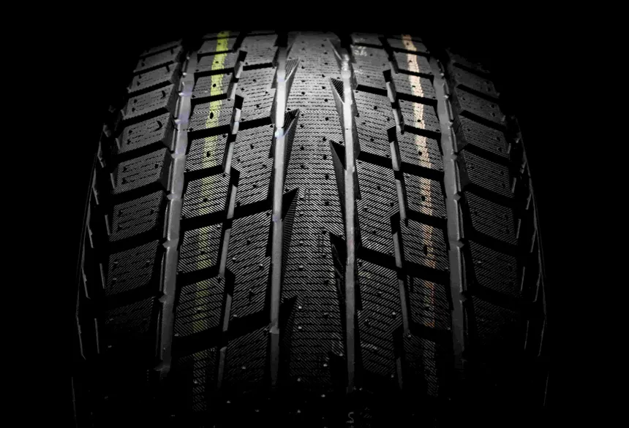

Your Solution: Automated Control System
A simple yet powerful computer system that automatically records every inbound and outbound tire, consistently applies discounts and sales tax calculations, and keeps your total inventory value updated in real-time. This guarantees transparency, accuracy, and sustainable profitability.
Record
Automatic tracking of tire ins and outs
Calculate
Error-free discounts, pricing, and sales tax
Control
Real-time inventory value updates
Prosper
Make decisions with reliable data

Slide 5
Next Steps: Your Competitive Advantage Starts Today
1
Implement Automation
Adopt a digital control system to eliminate manual errors and optimize your profitability now.
2
Access Real-Time Data
Make informed decisions on inventory, pricing, and brand strategy with accurate and up-to-date information.
3
Position for Growth
With full control of your inventory and clear margins, capitalize on market recovery and compete with confidence.

Slide 6
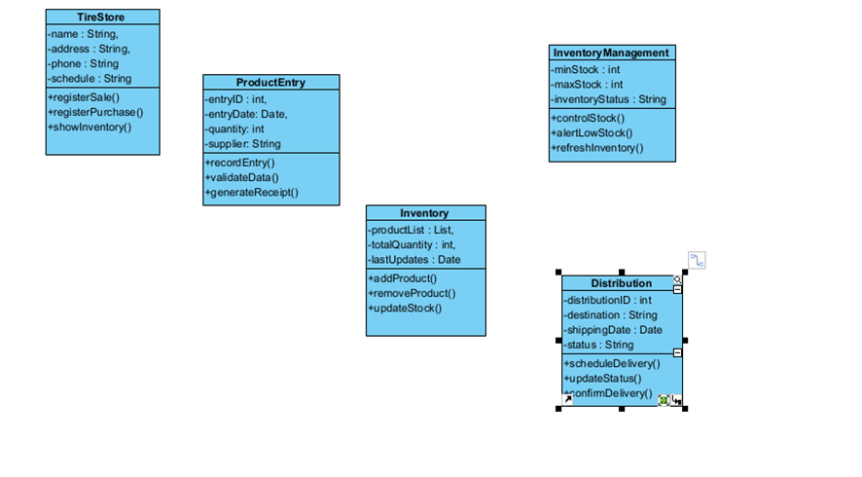

Slide 7
